Slide 1
Local Finance Updates
Fall Creek Falls April 28th & April 29th
Gatlinburg May 12th & May 13th
Paris Landing May 19th & May 20th
Pickwick Landing May 25th & May 26th

Slide 2
Local Finance Office
Main Line 615-532-1650
Brenda Pursley: eReporting reports, Ed Jobs, Transportation Report
615-532-2838 brenda.pursley@tn.gov
Karen Weidemann: PIRS & Attendance
615-532-1662 karen.weidemann@tn.gov
Kim Miller: Attendance website & System IDs and passwords
615-741-8835 kim.miller@tn.gov

Slide 3
Local Disbursements Office
Spencer Yonce: Director of Local Disbursements
615-532-4718 spencer.yonce@tn.gov
Debbie Dungan: Title Projects, IDEA
615-532-1657 debbie.dungan@tn.gov
Brenda Pursley: Carl Perkins, CSH, Pre-K
615-532-2838 brenda.pursley@tn.gov
Andrew McCluskey: USDA
615-532-1654 andrew.mccluskey@tn.gov

Slide 4
Local Finance Fiscal Consultants
Ron Adelman Jackson, Southwest FSC
Brad Davis Martin, Northwest FSC
Malinda White Shelbyville, South Central FSC
Bobby Palmer Cookeville, Upper Cumberland FSC
Carol Newton Cleveland, Southeast FSC
Jackie Broyles Johnson City, First TN FSC
Contact Brad Davis on BEP questions.

Slide 5
State Budget
2011 – 2012 Improvements
Description | Amounts | Amendment
Fully Funding BEP | $ 53,500,000 | $ 48,700,000
1.6% Salary Increase in the BEP | $ 36,300,000 | $ 36,300,000
Health Insurance in BEP 1/1/2011, last 6 months | $ 2,800,000 | $ 2,800,000
Health Insurance in BEP 1/1/2012, first 6 months | $ 5,700,000 | $ 0
Current Year BEP Growth | $ 8,700,000 | $ 4,000,000
Fully Funding Existing Pre-K Classrooms | $ 1,200,000 | $ 1,200,000
K-4 Math and Science PD ( TSU grant) | $ 2,000,000 | $ 2,000,000
Save the Children (6th year) | $ 500,000 | $ 500,000
Total Improvements | $ 110,700,000 | $ 96,200,000

Slide 6
State Budget
2011 – 2012 Programs Funded One-Time State Funds
Description | FY2012 State Amounts | FY2011 ARRA Amounts | % Change
Coordinated School Health | $ 15,090,000 | $ 15,370,100 | -1.8%
Extended Contracts | $ 15,000,000 | $ 15,000,000 | 0.0%
Internet Connectivity | $ 2,000,000 | $ 2,363,400 | -15.4%
Little TN Valley Education Cooperative | $ 47,700 | $ 47,700 | 0.0%
Public Television | $ 2,786,800 | $ 3,286,800 | -15.2%
Science Alliance Museums | $ 750,000 | $ 750,000 | 0.0%
Holocaust Commission | $ 128,300 | $ 128,300 | 0.0%
Arts Academy | $ 150,000 | $ 150,000 | 0.0%

Slide 7
State Budget
2011 – 2012 Programs Funded One-Time State Funds
Description | FY2012 State Amounts | FY2011 ARRA Amounts | % Change
Professional Development (includes CEO) | $ 582,000 | $ 582,000 | 0.0%
Exemplary Educators | $ 2,250,000 | $ 2,250,000 | 0.0%
SSMS | $ 2,700,000 | $ 3,700,000 | -27.0%
Family Resource Centers | $ 3,050,000 | $ 3,463,200 | -11.9%
Safe Schools | $ 4,841,200 | $ 4,841,200 | 0.0%
K - 2 Assessment | $ 1,300,000 | $ 2,284,400 | -43.1%
Operational Savings | $ - | $ 257,900 | -100.0%

Slide 8
State Budget
2011 – 2012 Programs Funded One-Time State Funds
Description | FY2012 State Amounts | FY2011 ARRA Amounts | % Change
Transportation | $ 800,000 | $ 800,000 | 0.0%
TEIS | $ - | $ 2,210,200 | -100.0%
Governor's Schools | $ 2,481,000 | $ 2,481,000 | 0.0%
Governor's Books from Birth Fund | $ 340,000 | $ 340,000 | 0.0%
Alvin C. York High School | $ 2,294,400 | $ 2,294,400 | 0.0%
BEP Current Year ADM Growth | $ 7,000,000 | $ 7,000,000 | 0.0%
Total | $ 63,591,400 | $ 69,600,600 | -8.6%

Slide 9
FY12 BEP
Estimate Dates:
April 20th
May 18th
June 17th
July Final, early July contingent on timely ADM
Capital Inflation from FY11 is not funded
TCA 49-351(a)(4)
Approximately $30 million state-wide

Slide 10
FY12 BEP
BEP Capital Outlay Change
TCA 49-3-351(a)(4)
In fiscal year 2010-2011 and subsequent fiscal years, the cost per square foot calculation in the capital outlay component shall be reduced by fourteen dollars ($14.00) per square foot for kindergarten through grade four (K-4) classrooms and by twelve dollars ($12.00) per square foot for other classrooms, it being the legislative intent that the state share of the BEP formula in 2010-2011 and subsequent fiscal years not include growth in capital outlay that otherwise would have occurred in fiscal year 2010-2011. The provisions of this item shall not preclude the appropriation of non-recurring funds to the BEP for distribution to local education agencies through the BEP formula.

Slide 11
FY12 BEP
BEP Capital Outlay Change
Grades | FY10 | FY11 | Reduction | FY11 BEP Recurring | FY11 BEP NonRecurring
K – 4 | $107 | $121 | $14 | $107 | $14
5 – 8 | $113 | $125 | $12 | $113 | $12
9 – 12 | $111 | $123 | $12 | $111 | $12
Grades | FY11 | FY12 | Reduction | FY12 BEP
K – 4 | $121 | $126 | $14 | $112
5 – 8 | $125 | $127 | $12 | $115
9 – 12 | $123 | $125 | $12 | $113

Slide 12
FY12 BEP
BEP Capital Outlay Change
Grades | FY10 | FY11 | Reduction | FY11 BEP Recurring | FY11 BEP NonRecurring
K – 4 | $107 | $121 | $14 | $107 | $14
5 – 8 | $113 | $125 | $12 | $113 | $12
9 – 12 | $111 | $123 | $12 | $111 | $12
Grades | FY11 | FY12 | Reduction | FY12 BEP
K – 4 | $121 | $128 | $14 | $114
5 – 8 | $125 | $129 | $12 | $117
9 – 12 | $123 | $126 | $12 | $114

Slide 13
FY12 BEP
ADM download
July Final Allocation will be sent in early July and is contingent on the timeliness of ADM data
Date | Download or Estimate Sent
April 1st | ADM downloaded
April 18th | ADM downloaded
April 20th | BEP estimate sent
May 2nd | ADM downloaded
May 16th | ADM downloaded
May 18th | BEP estimate sent
June 1st | ADM downloaded
June 16th | ADM downloaded
June 17th | BEP estimate sent

Slide 14
BEP Stability & Mandatory Increase
What is it?
TCA 49-3-366(b)
No LEA shall receive from the BEP in fiscal year 2004-2005 and in subsequent fiscal years a lesser amount of state funds for instructional salaries, benefits, insurance, and unit costs adjusted for any mandatory increases in these categories and adjusted for any changes in average daily membership, than it received for such purposes in the 2003-2004 fiscal year.
Stability is what an LEA generates in the prior year.
Mandatory Increase is in addition to stability and is funded when there is an increase for instructional salaries, benefits or insurance.

Slide 15
BEP Stability & Mandatory Increase
Several systems on stability in FY12
There has been a slight change in how the stability amount was calculated for FY12.
Only the recurring BEP dollars determined the stability amount.
This is noted on BEP Allocation page.

Slide 16
BEP Baseline & Mandatory Increase
Six systems on baseline in FY12
Created with BEP 2.0
Governed by TCA 49-3-307(a)(1)
Mandatory Increase is in addition to baseline and is funded when there is an increase for instructional salaries, benefits or insurance.
This is noted on BEP Allocation page.

Slide 17
GASB 54
Why did it come about?
Creditors/Lenders want an accurate account of a government’s fund balance
How much equity do governments really have?
Issues with misrepresentations of how much fund balance was not designated or already spoken for
What will it mean for school system accounting?
Dead balance sheet/Period 13
CTAS trainings

Slide 18
GASB 54
New Equity Sections
Nonexpendable
Restricted
Committed
Assigned
Unassigned
New accounts added to eReporting
The Office of Local Finance has one requirement
34560 only be used for Career Ladder Reserve
34560 will be pulled into CL Reconciliation Report

Slide 19
SFSF BEP
Make sure revenue is coded in 46512 in AFR
Cost center expenditures!
Many LEAs received their SFSF BEP funds in the April BEP payment
A few LEAs will also receive a portion of their SFSF BEP funds in June BEP payment
These LEAs will receive all their SFSF BEP in June
Carroll County
Fayette County
Hardeman County
Maury County
Union City
Perry County

Slide 20

SFSF Extended Contract
The FY11 allocation will be available to obligate until August 31, 2011
Final SFSF Extended Contract expenditures will be reported in eReporting on September 15, 2011
Payments:
December 29, 2010
April 21, 2011
July 19, 2011 (projected payment date)
September 20, 2011 (projected payment date)
If Extended Contract is funded in the FY12 state budget it will be accounted for as state funds

Slide 21
ARRA Recap
ARRA Project TN DOE Contacts
Program Contact Email
Title I, II-D, X Projects Eve Carney eve.carney@tn.gov
IDEA Projects Nan McKerley nan.mckerley@tn.gov
State Fiscal Stabilization Fund
Education (BEP) Wesley Robertson wesley.robertson@tn.gov
Government Services
CSH Jerry Swaim jerry.swaim@tn.gov
Extended Contract Kimberly Jackson kimberly.f.jackson@tn.gov
Family Resource Centers Jan Bushing jan.bushing@tn.gov
Safe Schools Mike Herrmann mike.herrmann@tn.gov
Internet Connectivity Lisa Howard lisa.howard@tn.gov
SSMS Lisa Howard lisa.howard@tn.gov
Professional Development Barry Olhausen barry.olhausen@tn.gov
First To The Top Marianna Smith marianna.smith@tn.gov
Education Jobs Fund Wesley Robertson wesley.robertson@tn.gov
USDA Sarah White sarah.white@tn.gov

Slide 22
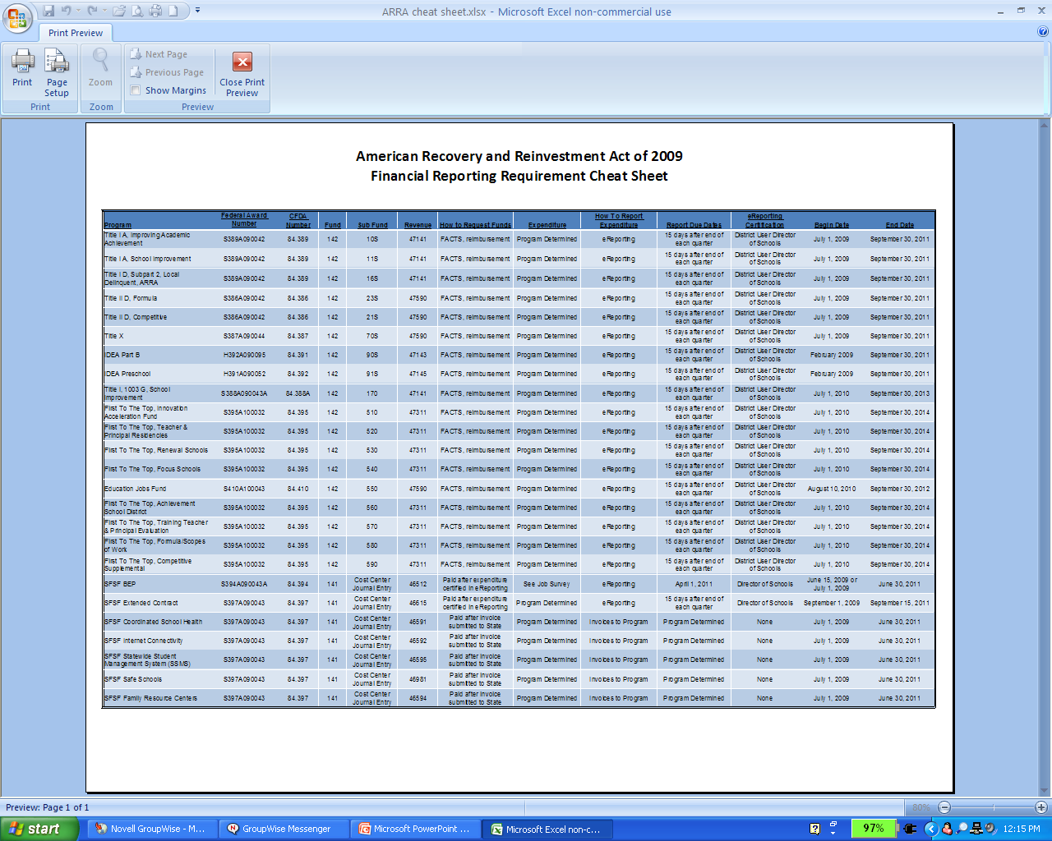
ARRA Recap

Slide 23
Education Jobs Fund
The State may not require an LEA to submit an application for Ed Jobs funds if the LEA has already submitted an SFSF application
Expenditures can span from August 10, 2010 to September 30, 2012
The statute prohibits LEAs from using Ed Jobs funds for general administrative expenses including administrative expenditures related to the operation of the superintendent’s office, the LEA’s board of education, and salaries and benefits of LEA-level administrative employees
Contracted services are also prohibited.

Slide 24
Education Jobs Fund
Salaries
Performance bonuses
Health insurance
Retirement benefits
Incentives for early retirement
Pension fund contributions
Tuition reimbursement
Student loan repayment assistance
Transportation subsidies
Reimbursement for childcare expenses

Slide 25
Education Jobs Fund
Principals
Assistant principals
Academic coaches
In-service teacher trainers
Classroom aides
Counselors
Librarians
Social workers
Interpreters
Physical, speech and occupational therapists
Security officers
Maintenance workers
Nurses
Bus drivers
Cafeteria workers

Slide 26
Education Jobs Fund
Quarterly Job Forms are sent to Brenda Pursley.
The Department will be monitoring State implementation of the Ed Jobs program
Expenditures must be reported in FACTS and eReporting

Slide 27
PIRS
Year End Reporting will open May 2, 2011
August 31, 2011 due date
Certify Year End report in eReporting
Months and days are only data that is pulled
Salary is not pulled or reviewed with Year End Report
PIRS training at TASBO in the Fall
Contact: Karen Weidemann 615-532-1662

Slide 28
Local Finance Reports
Report | Due Date
County Trustee/City Treasurer/Fiscal Agent Report | July 15th
Transportation Report | July 15th
Career Ladder Reconciliation Report | August 1st
Annual Public School Financial Report | August 1st
Annual Public School Budget Document | July 1st or October 1st if on continuation budget
MOE Test | Budget Test
3% Fund Balance Test | Budget Test

Slide 29
MOE
MOE is a continuous budget to budget test.
MOE only applies to local recurring revenue.
Local recurring revenue must be equal to prior years local recurring revenue.
Budget is also compared to actual to determine if a BEP Reserve is established.
This test is on eReporting.

Slide 30
3% Fund Balance
3% Fund Balance test is only applicable if fund balance is needed to balance the budget.
If fund balance is needed to balance the budget, an LEA can only use the fund balance that is in excess of 3% of its operating expenditures.
There is NO requirement to have 3% of fund balance.
This test is on eReporting.

Slide 31
TCRS Update
TCRS is ranked in top of all pensions plan in the world (public and private)
Retirement incentives do not count for retirement purposes
Contribution Rates revised every 2 years.
$2.7 billion unfunded accrued liability
State and Teacher plans 90.64% funded
History of LEA contribution rates:
Year | Rate | % Change
FY05/FY06 | 5.89%
FY07/FY08 | 6.24% | 5.9%
FY09/FY10 | 6.42% | 2.9%
FY11/FY12 | 9.05% | 41%

Slide 32
TCRS Update
$2.7 billion unfunded accrued liability
Paid back over next 20 years
These future rates reflect 7.5% estimated growth
What does this mean for future rates?:
http://treasury.tn.gov/tcrs/PDFs/TCRSPlanUpdate2011.pdf
Year | Rate | % Change
FY11/FY12 | 9.05% | 41%
FY13/FY14 | 9.69% | 7%
FY15/FY16 | 12.89% | 33%
FY17/FY18 | 15.17% | 18%
FY19/FY20 | 15.29% | 1%
Year | Rate | % Change
FY21/FY22 | 14.69% | -4%
FY23/FY24 | 14.11% | -4%
FY25/FY26 | 13.57% | -4%
FY27/FY28 | 13.35% | -2%
FY29/FY30 | 13.00%? | -3%

Slide 33
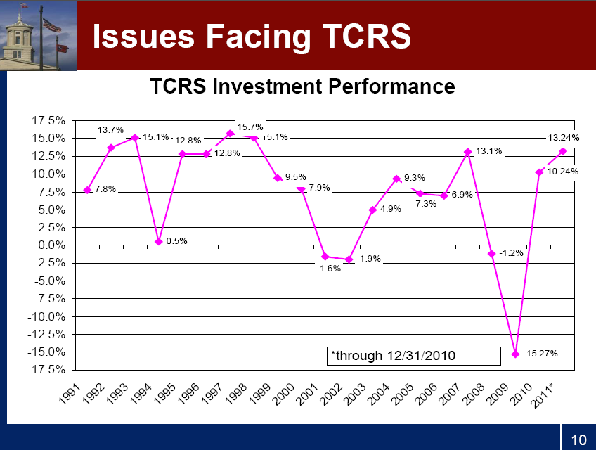

Slide 34
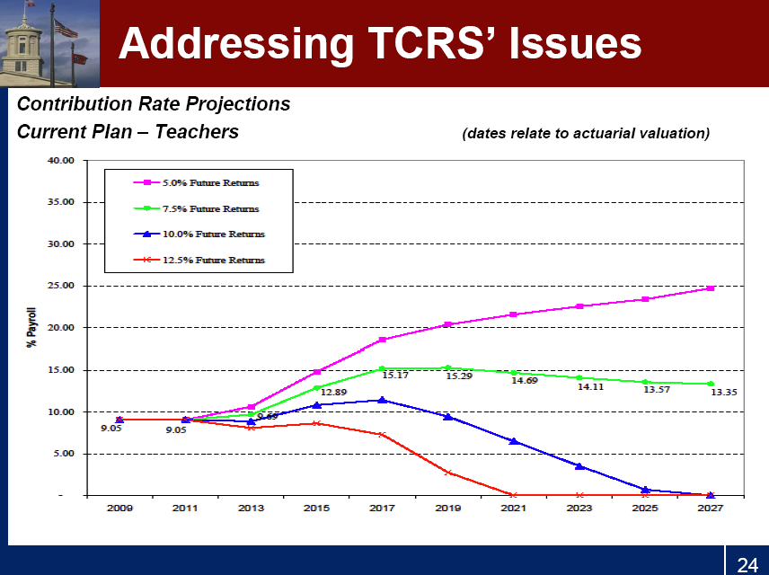

Slide 35
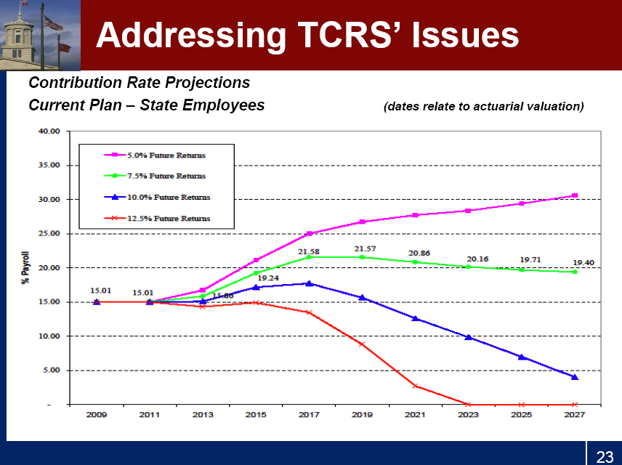

Slide 36
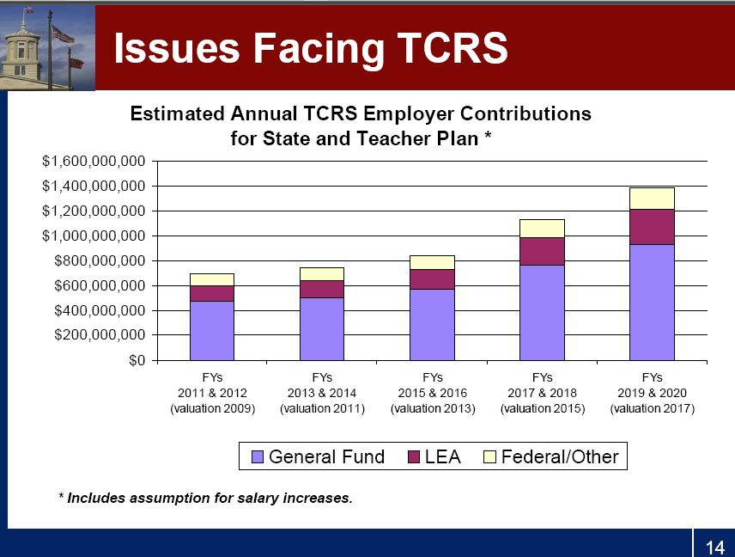

Slide 37
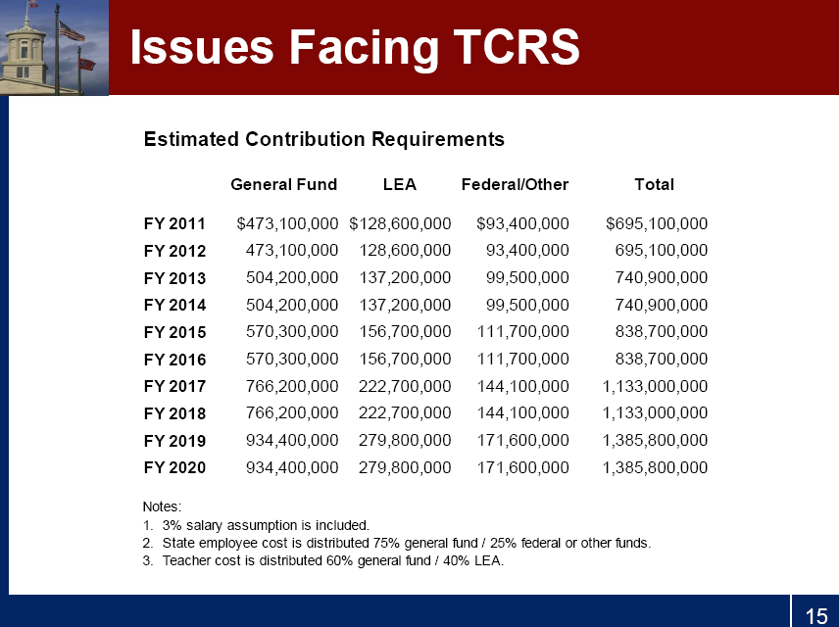

Slide 38
Revised Internal School Uniform Accounting Policy Manual
Posted to Department’s website within a few weeks
Collaborative effort between the DOE and Municipal Audit
No major changes
Booster bill incorporated
P-cards should be handled just as normal purchase
Finance seminars are highly recommended

Slide 39
Questions

